Slide 1

Object Oriented Programming (OOP) Course Code: CSE2005/SWE2005
MODULE – 3
(Exception Handling)
By:
Dr. Nagendra Panini Challa
Assistant Professor, Senior Grade 2
SCOPE, VIT-AP University, India

Slide 2
Agenda
Exceptions
Exception Hierarchy
Throwing and Catching Exceptions
Multiple Catch clause
Nested Try Statement
Throw
Throws
Finally
Built in exceptions
User Defined Exceptions

Slide 3
Exception Handling
The Exception Handling in Java is one of the powerful mechanism to handle the runtime errors so that the normal flow of the application can be maintained.
What is Exception in Java? In Java, an exception is an event that disrupts the normal flow of the program. It is an object which is thrown at runtime.
What is Exception Handling? Exception Handling is a mechanism to handle runtime errors such as ClassNotFoundException, IOException, SQLException, RemoteException, etc.
Advantage of Exception Handling
The core advantage of exception handling is to maintain the normal flow of the application. An exception normally disrupts the normal flow of the application; that is why we need to handle exceptions.

Slide 4
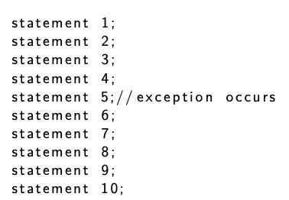
Suppose there are 10 statements in a Java program and an exception occurs at statement 5; the rest of the code will not be executed, i.e., statements 6 to 10 will not be executed. However, when we perform exception handling, the rest of the statements will be executed. That is why we use exception handling in Java.

Slide 5
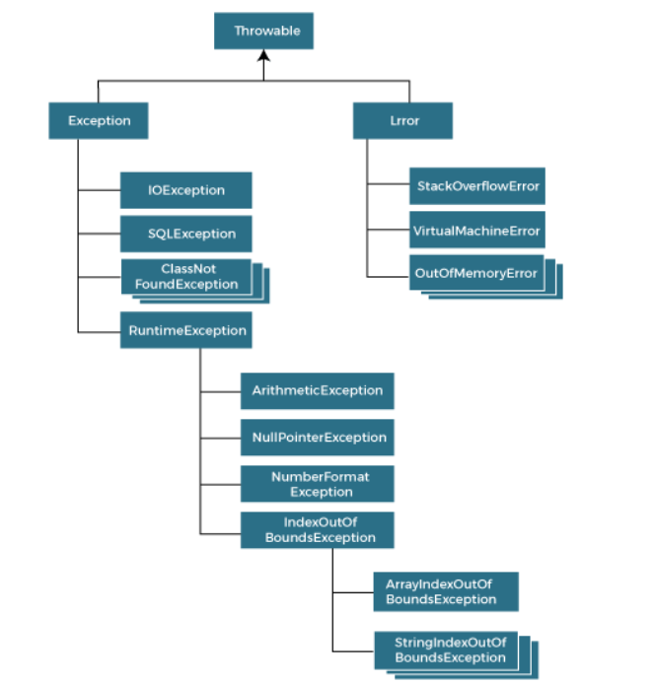
Hierarchy of Java Exception Class
The java.lang.Throwable class is the root class of Java Exception hierarchy inherited by two subclasses: Exception and Error. The hierarchy of Java Exception classes is given below:

Slide 6
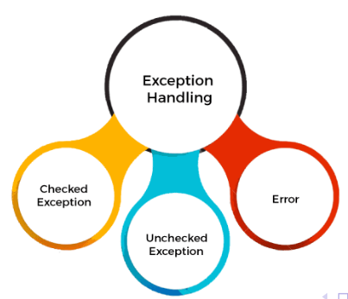
Types of Java Exceptions
There are mainly two types of exceptions: checked and unchecked. An error is considered as the unchecked exception.
However, according to Oracle, there are three types of exceptions namely:
Checked Exception
Unchecked Exception
Error

Slide 7
Difference between Checked and Unchecked Exceptions
Checked Exception
The classes that directly inherit the Throwable class except RuntimeExcep- tion and Error are known as checked exceptions. For example, IOException, SQLException, etc. Checked exceptions are checked at compile-time.
Unchecked Exception
The classes that inherit the RuntimeException are known as unchecked exceptions. For example, ArithmeticException, NullPointerException, Ar- rayIndexOutOfBoundsException, etc. Unchecked exceptions are not checked at compile-time, but they are checked at runtime.
Error
Error is irrecoverable. Some example of errors are OutOfMemoryError, Vir- tualMachineError, AssertionError etc.

Slide 8
How JVM handles Exception?
Whenever inside a method, if an exception has occurred, the method creates an Object known as an Exception Object and hands it off to the run-time system(JVM).
The exception object contains the name and description of the exception and the current state of the program where the exception has occurred.
Creating the Exception Object and handling it in the run-time system is called throwing an Exception.
There might be a list of the methods that had been called to get to the method where an exception occurred. This ordered list of the methods is called Call Stack.

Slide 9
The run-time system searches the call stack to find the method that contains a block of code that can handle the occurred exception. The block of the code is called an Exception handler.
The run-time system starts searching from the method in which the exception occurred, and proceeds through the call stack in the reverse order in which methods were called.
If it finds an appropriate handler then it passes the occurred exception to it. An appropriate handler means the type of the exception object thrown matches the type of the exception object it can handle.
If the run-time system searches all the methods on the call stack and couldn’t have found the appropriate handler then the run-time system handover the Exception Object to the default exception handler, which is part of the run-time system. This handler prints the exception information and terminates the program abnormally.

Slide 10
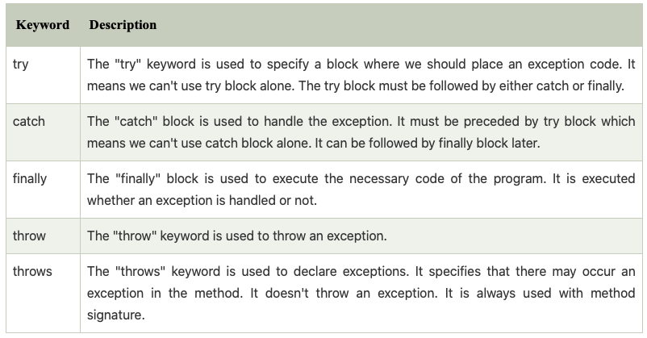
Java Exception Keywords
Java provides five keywords that are used to handle the exception. The following table describes each.

Slide 11
Java Try-Catch Block
Java try block is used to enclose the code that might throw an exception. It must be used within the method.
If an exception occurs at the particular statement in the try block, the rest of the block code will not execute. So, it is recommended not to keep the code in try block that will not throw an exception.
Java try block must be followed by either catch or finally block.
Syntax of try-catch block
try{ //code that may throw an exception }
catch(Exception class Name ref){}
Syntax of try-finally block
try{ //code that may throw an exception } f i n a l l y {}

Slide 12
Java catch block is used to handle the Exception by declaring the type of exception within the parameter.
The declared exception must be the parent class exception ( i.e., Exception) or the generated exception type.
The good approach is to declare the generated type of exception.
The catch block must be used after the try block only.
You can use multiple catch block with a single try block.

Slide 13
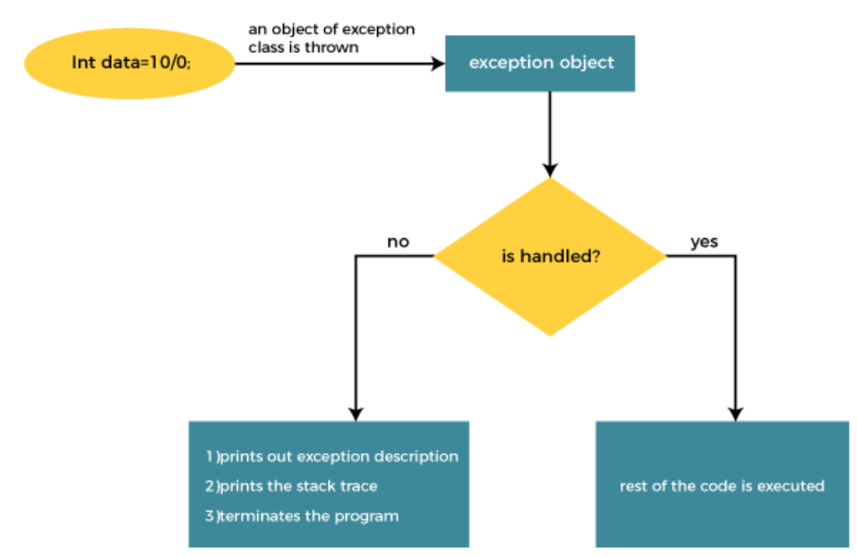

Slide 14
Without Try-Catch Block
Output:
Arithmetic Exception
divided by zero
public class TryCatchExample1 {
public static void main(String[] args) {
int data=50/0; //may throw exception
System.out.println("rest of the code");
}
}

Slide 15
Example-1
In this example, 100/0 raises an ArithmeticException which is handled by a try-catch block.
public class JavaExceptionExample{
public static void main(String args[]){
try {
//code that may raise exception
int data=100/0;
}
catch(ArithmeticException e){
System.out.println(e);}
//rest code of the program
System.out.println("rest of the code...");
} }
Output:
Arithmetic Exception divided by zero
rest of the code...

Slide 16
Example-2
Here, we can see that if an exception occurs in the try block, the rest of the block code will not execute.
public class TryCatchExample3 {
public static void main(String[] args) {
try
{
int data=50/0; //may throw exception
// if exception occurs, the remaining statement will not execute
System.out.println("rest of the code");
}
// handling the exception
catch(ArithmeticException e)
{
System.out.println(e);
} } }
Output:
Arithmetic
exception divided by zero

Slide 17
Example-3
If exception occurs, Custom message can be printed
public class TryCatchExample5 {
public static void main(String[] args) {
try
{
int data=50/0; //may throw exception
}
// handling the exception
catch(Exception e)
{
// displaying the custom message
System.out.println("Can't divided by zero");
} } }
Output:
Can’t divided by zero

Slide 18
Example-4
public class TryCatchExample6 {
public static void main(String[] args) {
int i=50;
int j=0;
int data;
try
{
data=i/j; //may throw exception
}
// handling the exception
catch(Exception e)
{
// resolving the exception in catch block
System.out.println(i/(j+2));
}
}
}
Output:
25

Slide 19
Example-5
public class TryCatchExample7 {
public static void main(String[] args) {
try
{
int data1=50/0; //may throw exception
}
// handling the exception
catch(Exception e)
{
// generating the exception in catch block
int data2=50/0; //may throw exception
}
System.out.println("rest of the code");
}
}
Here, we can see that the catch block didn't contain the exception code. So, enclose exception code within a try block and use catch block only to handle the exceptions.
Output:
Exception in thread main
TryCatchexample7 divided
by zero

Slide 20
Example-6
import java.io.FileNotFoundException;
import java.io.PrintWriter;
public class TryCatchExample10 {
public static void main(String[] args) {
PrintWriter pw;
try {
pw = new PrintWriter("jtp.txt"); //may throw exception
pw.println("saved");
}
// providing the checked exception handler
catch (FileNotFoundException e) {
System.out.println(e);
}
System.out.println("File saved successfully");
}
}
Output:
File saved successfully

Slide 21
Common Scenarios of Java Exceptions
There are given some scenarios where unchecked exceptions may occur. They are as follows:
1) A scenario where ArithmeticException occurs
If we divide any number by zero, there occurs an ArithmeticException.
int a=50/0; //ArithmeticException

Slide 22
2) A scenario where NullPointerException occurs
If we have a null value in any variable, performing any operation on the variable throws a NullPointerException.
String s=null;
System.out.println(s.length()); //NullPointerException

Slide 23
3) A scenario where NumberFormatException occurs
If the formatting of any variable or number is mismatched, it may result into NumberFormatException.
Suppose we have a string variable that has characters; converting this variable into digit will cause NumberFormatException.
String s="abc";
int i=Integer.parseInt(s); //NumberFormatException

Slide 24
4) A scenario where ArrayIndexOutOfBoundsException occurs
When an array exceeds to it's size, the ArrayIndexOutOfBoundsException occurs. there may be other reasons to occur ArrayIndexOutOfBoundsException.
Consider the following statements.
int a[]=new int[5];
a[10]=50; //ArrayIndexOutOfBoundsException

Slide 25
Multi-catch block
A try block can be followed by one or more catch blocks.
Each catch block must contain a different exception handler. So, if you have to perform different tasks at the occurrence of different exceptions, use java multi-catch block.
At a time only one exception occurs and at a time only one catch block is executed.
All catch blocks must be ordered from most specific to most general, i.e. catch for ArithmeticException must come before catch for Exception.

Slide 26
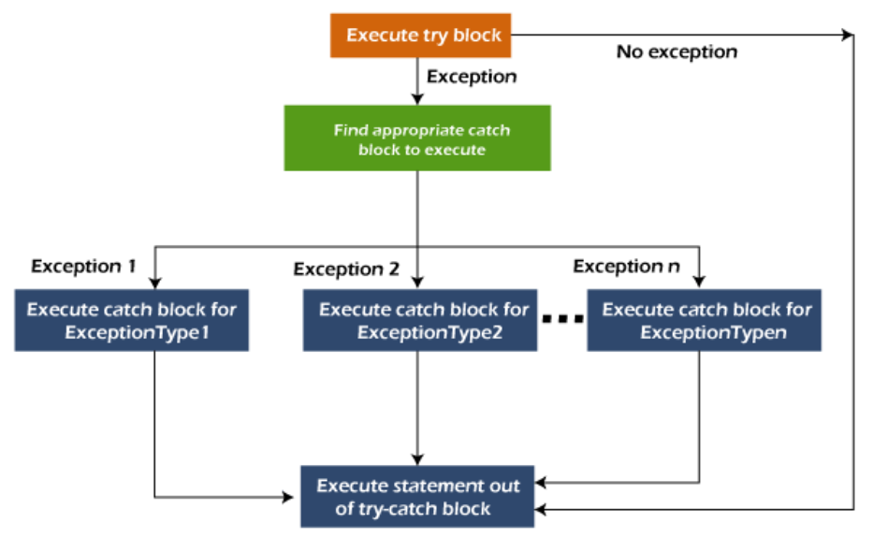

Slide 27
Example-1
public class MultipleCatchBlock1 { public static void main(String [] args) {
try{
int a[]=new int [5]; a[5]=30/0; // exception occurred } catch(ArithmeticException e) {
System.out.println(”Arithmetic Exception occurs”); }
catch(ArrayIndexOutOfBoundsException e) {
System.out. println(”ArrayIndexOutOfBounds”); } catch(Exception e) {System.out.println(”Parent Exception occurs”); } System.out.println(”rest of the code”);
}}
Output:
Arithmetic Exception occurs
rest of the code

Slide 28
Example-2
Output:
ArrayIndexOutOfBounds
rest of the code
public class MultipleCatchBlock2 { public static void main(String [] args) {
try{
int a[]=new int [5]; System . out . p r i n t l n ( a [ 10 ] ) ; } catch(ArithmeticException e) {
System.out.println(”Arithmetic Exception occurs”); } catch(ArrayIndexOutOfBoundsException e) {
System.out. println(”ArrayIndexOutOfBounds”); } catch(Exception e) {System.out.println(”Parent Exception occurs”); } System.out.println(”rest of the code”);
}}
Output:
If array size is decreased,
then
O
Rest of the code

Slide 29
Example-3
In this example, try block contains two exceptions. But at a time only one exception occurs and its corresponding catch block is executed.
public class MultipleCatchBlock3 { public static void main(String [] args) {
try{
int a[]=new int [5]; a[5]=30/0; System . out . p r i n t l n ( a [ 1 0 ] ) ; } catch(ArithmeticException e) {
System.out.println(”Arithmetic Exception occurs”); } catch(ArrayIndexOutOfBoundsException e) {
System.out. println(”ArrayIndexOutOfBounds”);} catch(Exception e) {System.out.println(”Parent Exception occurs”); } System.out.println(”rest of the code”); }}
Output:
Arithmetic Exception occurs
rest of the code

Slide 30
Example-4
In this example, we generate NullPointerException, but didn't provide the corresponding exception type. In such case, the catch block containing the parent exception class Exception will invoked.
public class MultipleCatchBlock3 { public static void main(String [] args) {
try{ String s = null ;
System . out . p r i n t l n ( s . l e n g t h ( ) ) ;
}
catch(ArithmeticException e) {
System.out.println(”Arithmetic Exception occurs”); } catch(ArrayIndexOutOfBoundsException e) {
System.out. println(”ArrayIndexOutOfBounds”);}
catch(Exception e) {System.out.println(”Parent Exception occurs”); } System.out.println(”rest of the code”); }}
Output:
Parent Exception occurs
rest of the code

Slide 31
Nested try block
In Java, using a try block inside another try block is permitted. It is called as nested try block.
Why use nested try block Sometimes a situation may arise where a part of a block may cause one error and the entire block itself may cause another error. In such cases, exception handlers have to be nested.
//try catch block within nested try block
try //inner try block-2
{
statement 5;
statement 6; } catch(Exception e2)
{
//parent outer//main try block
try
{
statement 1; statement 2; //try catch block within another try block
try //inner try block-1
{
statement 3;
statement 4;
//exception message
}}
catch(Exception e1)
{
//exception message
}}
//catch block of parent (outer) try block
catch(Exception e3) { //exception message
}

Slide 32
When any try block does not have a catch block for a particular exception, then the catch block of the outer (parent) try block are checked for that exception, and if it matches, the catch block of outer try block is executed.
If none of the catch block specified in the code is unable to handle the exception, then the Java runtime system will handle the exception. Then it displays the system generated message for that exception.

Slide 33
Example-1
/inner try block 2
try{
int a[]=new int [5];
//assigning the value out of array bounds
a[5]=4; }
//catch block of inner try block 2 catch(ArrayIndexOutOfBoundsException e) {
System . out . p r i n t l n ( e ) ;
}
System . out . println (” other statement ”);
} }
Output:
going to divide by zero
Arithmetic Exception
ArrayIndexOutOfBoundsException
other statement
normal flow
public class NestedTryBlock{ public static void main(String args []){
//main outer //parent outer try block
Try
{
//inner try block 1
Try
{
System.out.println(”going to divide by 0”);
int b =39/0;
}
//catch block of inner try block 1
catch(ArithmeticException e) {
System . out . p r i n t l n ( e ) ;
//catch block of main outer//parent outer try block
catch(Exception e) {
System.out.println(”handled the exception (outer c”);
}
System.out.println(”normal flow..”);
} }

Slide 34
Example-2
// to handle ArithmeticException
catch (ArithmeticException e) {
System.out.println(”Arithmetic exception”);
System.out.println(”inner try block 1”);
}}
// to handle ArrayIndexOutOfBoundsException
catch (ArrayIndexOutOfBoundsException e4)
{
System . out . p r i n t ( e4 ) ; System . out . println (” outer (main) try block”);
} catch (Exception e5) { System . out . print (” Exception ”);
System . out . println (” handled in main try−block ”);
}}}
public class NestedTryBlock2 {
public static void main(String args [])
{
// outer (main) try block
try {
//inner try block 1
try {
// inner try block 2 try {
int arr[]={1,2,3,4};
//printing the array element out of its bounds
System . out . println ( arr [10]);}
// to handles ArithmeticException catch (ArithmeticException e)
{
System.out.println(”Arithmetic exception”); System.out.println(” inner try block 2”);
}}
Output:
ArrayIndexOutOfBoundsException
Outer (main) try block

Slide 35
Java finally block
Java finally block is a block used to execute important code such as closing the connection, etc.
Java finally block is always executed whether an exception is handled or not. Therefore, it contains all the necessary statements that need to be printed regardless of the exception occurs or not.
The finally block follows the try-catch block.
Why use Java finally block? finally block in Java can be used to put ”cleanup” code such as closing a file, closing connection, etc.
The important statements to be printed can be placed in the finally block.

Slide 36
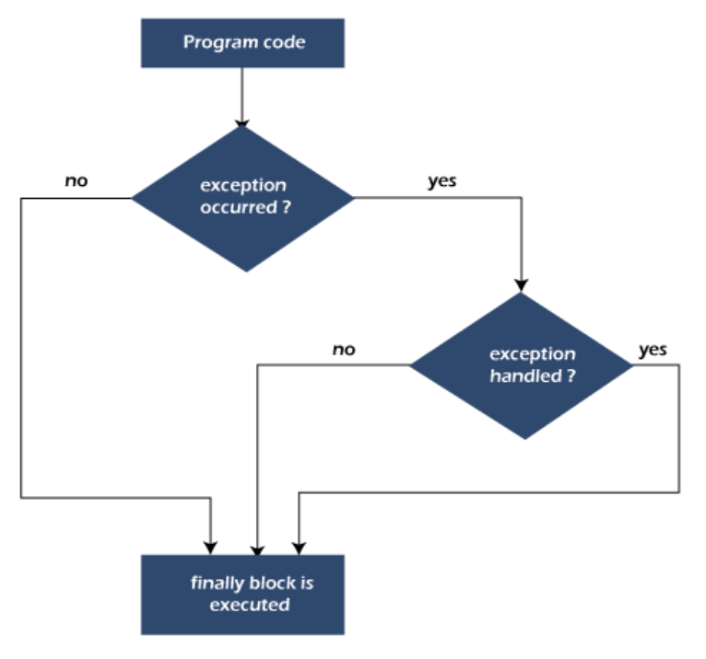

Slide 37
Example-1
class TestFinallyBlock { public static void main(String args []){
try{
//below code do not throw any exception
i n t data =25/5; System.out. println(data);}
//catch won’t be executed
catch(NullPointerException e){ System.out. println(e);} //executed regardless of exception occurred or not
finally {
System.out.println(”finally block is always executed”) System.out.println(”rest of the code...”);
}}
Output:
5
finally block is always executed
rest of the code...

Slide 38
Example-2
public class TestFinallyBlock1{ public static void main(String args []){ try { System.out.println(”Inside the try block”);
//below code throws divide by zero exception
i n t data =25/0; System.out.println(data); }
//cannot handle Arithmetic type exception //can only accept Null Pointer type exception catch(NullPointerException e)
{ System.out. println(e);
} //executes regardless of exception occured or not
finally { System.out.println(”finally block is always executed”)
System.out.println(”rest of the code...”);
}}
Output:
finally block is always executed
rest of the code
Java.lang.arithmetic exception

Slide 39
Example-3
public class TestFinallyBlock2{ public static void main(String args []){
try {
System.out.println(”Inside try block”);
//below code throws divide by zero exception
i n t data =25/0;
System.out.println(data); }
//handles the Arithmetic Exception / Divide by zero catch(ArithmeticException e){ System . out . println (” Exception handled ”); System . out . p r i n t l n ( e ) ;
}
//executes regardless of exception occured or not
finally {
System.out.println(”finally block is always executed”) System.out.println(”rest of the code...”);
}}
Output:
Exception handled
Finally block is always executed
Rest of the code...

Slide 40
Throw Keyword
The Java throw keyword is used to throw an exception explicitly.
We specify the exception object which is to be thrown. The Exception has some message with it that provides the error description.
We can throw either checked or unchecked exceptions in Java by throw keyword. It is mainly used to throw a custom exception.
We can also define our own set of conditions and throw an exception explicitly using throw keyword.
For example, we can throw ArithmeticException if we divide a number by another number.
Here, we just need to set the condition and throw exception using throw keyword.

Slide 41
throw instance;
Example
throw new IOException(”sorry device error ”);
Where the Instance must be of type Throwable or subclass of Throwable. For example, Exception is the sub class of Throwable and the user-defined exceptions usually extend the Exception class.

Slide 42
Example 1
public class TestThrow1 { //function to check if person is eligible to vote or not
public static void validate(int age) {
if(age<18) {
//throw Arithmetic exception if not eligible to vote
throw new ArithmeticException(”Person is not eligible for vote”);
else {
System.out.println(”Person is eligible to vote!”);
}} // main method
public static void main(String args []){ //calling the function
validate (13); System.out.println(”rest of the code...”);
}}
Output:
Java.lang arithmetic exception
Person is not eligible for vote

Slide 43
Example 2
import java . io .∗; public class TestThrow2 { public static void method() throws FileNotFoundExcepti
FileReader file = new FileReader(”C:\\Users\\DELL E744”);
BufferedReader fileInput = new BufferedReader( file );
throw new FileNotFoundException ();
} public static void main(String args []){ try
{ method(); } catch (FileNotFoundException e) {
e. printStackTrace (); }
System.out.println(”rest of the code...”);
}}

Slide 44
Example 3
// class represents user−defined exception
class UserDefinedException extends Exception
{
public UserDefinedException(String str) {
// Calling constructor of parent Exception
super(str);
}} // Class that uses above MyException
public class TestThrow3 {
public static void main(String args[]) {
try
{
// throw an object of user defined exception
throw new UserDefinedException(”This is user−defined “);
} catch (UserDefinedException ude) {
System.out.println(”Caught the exception”);
System . out . p r i n t l n ( ude . getMessage ( ) ) ; }}
Look into this code

Slide 45
Exception Propagation
Output:
exception handled
normal flow...
An exception is first thrown from the top of the stack and if it is not caught, it drops down the call stack to the previous method. If not caught there, the exception again drops down to the previous method, and so on until they are caught or until they reach the very bottom of the call stack. This is called exception propagation.
class TestExceptionPropagation1{
void m(){
int data =50/0;
} void n(){
m();
} void p(){
try{
n();
}
Catch (Exception e){
System.out.println(”exception handled”);
}}
public static void main(String args []){
TestExceptionPropagation1 obj=new TestExceptionPropagation();
obj .p(); System.out.println(”normal flow...”);
}}

Slide 46
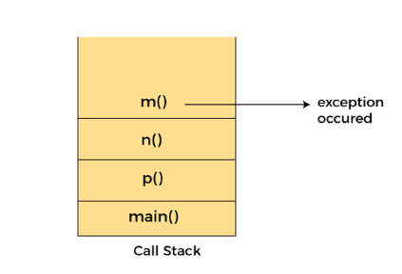

Slide 47
Example
class TestExceptionPropagation2{
void m(){
throw new java . io . IOException (” device error ”);
} void n(){
m(); }
void p(){
try{ n();}
catch(Exception e){
System.out.println(”exception handled”);
public static void main(String args []){
TestExceptionPropagation2 obj=new TestExceptionPropagation2 ();
obj .p();
System.out.println(”normal flow”);
}}

Slide 48
Java Throws Keyword
The Java throws keyword is used to declare an exception.
It gives an information to the programmer that there may occur an exception.
So, it is better for the programmer to provide the exception handling code so that the normal flow of the program can be maintained.
Exception Handling is mainly used to handle the checked exceptions.
If there occurs any unchecked exception such as NullPointerException, it is programmers’ fault that he is not checking the code before it being used.
return type method name() throws exception class name{
//method code }

Slide 49
Which exception should be declared?
Checked exception only, because: unchecked exception: under our control so we can correct our code.
error: beyond our control. For example, we are unable to do anything if there occurs VirtualMachineError or StackOverflowError.
Advantage of Java throws keyword Now Checked Exception can be propagated (forwarded in call stack). It provides information to the caller of the method about the exception.

Slide 50
Example-1
Rule: If we are calling a method that declares an exception, we must either caught or declare the exception. There are two cases: Case 1: We have caught the exception i.e. we have handled the exception using try/catch block.
Case 2: We have declared the exception i.e. specified throws keyword with the method.
import java . io . IOException ;
class Testthrows1{ void m() throws IOException{
throw new IOException(”device error”);//checked excep
void n() throws IOException{
m(); }
void p(){
try{
n(); }catch(Exception e){
System.out.println(”exception handled”);
public static void main(String args []){
Testthrows1 obj=new Testthrows1 ();
obj .p(); System.out.println(”normal flow...”);}}
Output:
exception handled
normal flow...

Slide 51
Example-2
import java . io .∗;
class M{
void method()throws IOException{
throw new IOException (” device error”);
public class Testthrows2;
{
public static void main(String args []){
try{ M m=new M();
m. method ( ) ;
}}}
catch(Exception e){ System . out . println (” exception handled ”);}
System.out.println(”normal flow...”);
}}
Output:
exception handled
normal flow

Slide 52
Example-3
import java . io .∗;
class M{
void method()throws IOException{ throw new IOException (” device error ”); }}
class Testthrows4{ public static void main(String args[])throws IOException
M m=new M();
m. method ( ) ;
System.out.println(”normal flow...”);
}}
Output:
Error will occur

Slide 53
Object Oriented Programming (OOP) Course Code: CSE2005/SWE2005
MODULE – 4
(The Collection Framework and Generic Programming)
By:
Dr. Nagendra Panini Challa
Assistant Professor, Senior Grade 2
SCOPE, VIT-AP University, India

Slide 54
Agenda
Collection -Overview
Collection Interface
List, Set, Map
Collection Classes
Array List
Linked List
HashSet
HashMap - Using an Iterator
For each
Comparators
Wrapper Classes
Motivation for Generic Programming
Generic Classes and Methods
Bounded Types
Wildcard Arguments
Generic Constructors and Interfaces

Slide 55
Collections - Overview
Any group of individual objects which are represented as a single unit is known as the collection of the objects.
In Java, a separate framework named the “Collection Framework” has been defined in JDK 1.2 which holds all the collection classes and interface in it.
The Collection interface (java.util.Collection) and Map interface (java.util.Map) are the two main “root” interfaces of Java collection classes.

Slide 56
Framework
A framework is a set of classes and interfaces which provide a ready-made architecture.
In order to implement a new feature or a class, there is no need to define a framework.
However, an optimal object-oriented design always includes a framework with a collection of classes such that all the classes perform the same kind of task.

Slide 57
Need for a Separate Collection Framework
Before the Collection Framework(or before JDK 1.2) was introduced, the standard methods for grouping Java objects (or collections) were Arrays or Vectors, or Hashtables.
All of these collections had no common interface.
Therefore, though the main aim of all the collections is the same, the implementation of all these collections was defined independently and had no correlation among them.
And also, it is very difficult for the users to remember all the different methods, syntax, and constructors present in every collection class.

Slide 58
Example
// Java program to demonstrate
// why collection framework was needed
import java.io.*;
import java.util.*;
class CollectionDemo {
public static void main(String[] args)
{
// Creating instances of the array,
// vector and hashtable
int arr[] = new int[] { 1, 2, 3, 4 };
Vector<Integer> v = new Vector();
Hashtable<Integer, String> h = new Hashtable();
// Adding the elements into the
// vector
v.addElement(1);
v.addElement(2);
// Adding the element into the
// hashtable
h.put(1, "geeks");
h.put(2, "4geeks");
// Array instance creation requires [],
// while Vector and hastable require ()
// Vector element insertion requires addElement(),
// but hashtable element insertion requires put()
// Accessing the first element of the
// array, vector and hashtable
System.out.println(arr[0]);
System.out.println(v.elementAt(0));
System.out.println(h.get(1));
// Array elements are accessed using [],
// vector elements using elementAt()
// and hashtable elements using get()
}
}
Output:
1
1
geeks

Slide 59
As we can observe, none of these collections(Array, Vector, or Hashtable) implements a standard member access interface, it was very difficult for programmers to write algorithms that can work for all kinds of Collections.
Another drawback is that most of the ‘Vector’ methods are final, meaning we cannot extend the ’Vector’ class to implement a similar kind of Collection.
Therefore, Java developers decided to come up with a common interface to deal with the above-mentioned problems and introduced the Collection Framework in JDK 1.2 post which both, legacy Vectors and Hashtables were modified to conform to the Collection Framework.

Slide 60
Advantages
Consistent API: The API has a basic set of interfaces like Collection, Set, List, or Map, all the classes (arraylist, linkedlist, Vector, etc) that implement these interfaces have some common set of methods.
Reduces programming effort: A programmer doesn’t have to worry about the design of the Collection but rather he can focus on its best use in his program. Therefore, the basic concept of Object-oriented programming (i.e.) abstraction has been successfully implemented.
Increases program speed and quality: Increases performance by providing high-performance implementations of useful data structures and algorithms because in this case, the programmer need not think of the best implementation of a specific data structure. He can simply use the best implementation to drastically boost the performance of his algorithm/program.

Slide 61
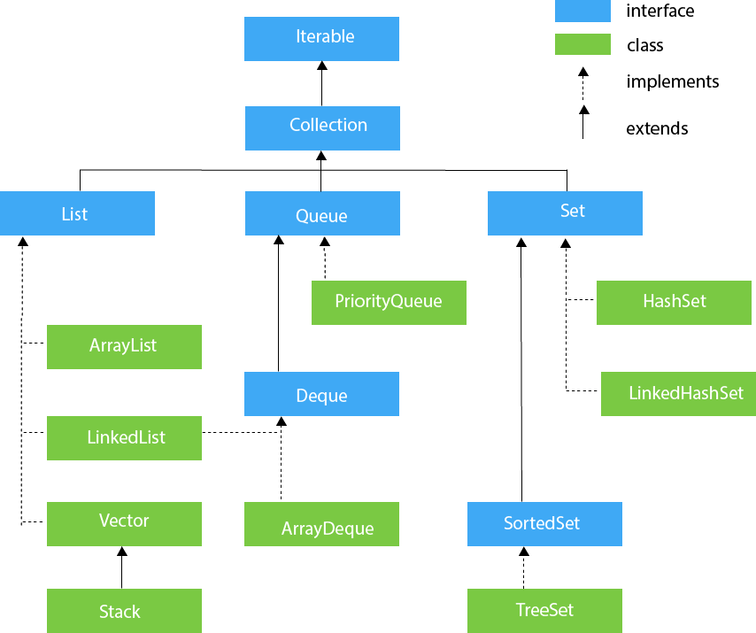
The utility package, (java.util) contains all the classes and interfaces that are required by the collection framework.
The collection framework contains an interface named an iterable interface which provides the iterator to iterate through all the collections.
This interface is extended by the main collection interface which acts as a root for the collection framework.
All the collections extend this collection interface thereby extending the properties of the iterator and the methods of this interface.
The following figure illustrates the hierarchy of the collection framework.

Slide 62
The Collection in Java is a framework that provides an architecture to store and manipulate the group of objects.
Java Collections can achieve all the operations that you perform on a data such as searching, sorting, insertion, manipulation, and deletion.
A Collection represents a single unit of objects, i.e., a group.
The java.util package contains all the classes and interfaces for the Collection framework.
Java Collection framework provides framework provides many interfaces (Set, List, Queue, Deque)
classes (ArrayList, Vector, LinkedList, PriorityQueue, HashSet, LinkedHashSet, TreeSet).

Slide 63
It provides readymade architecture.
It represents a set of classes and interfaces.
It is optional.
What is Collection framework
The Collection framework represents a unified architecture for storing and manipulating a group of objects. It has:
Interfaces and its implementations, i.e., classes
Algorithm

Slide 64
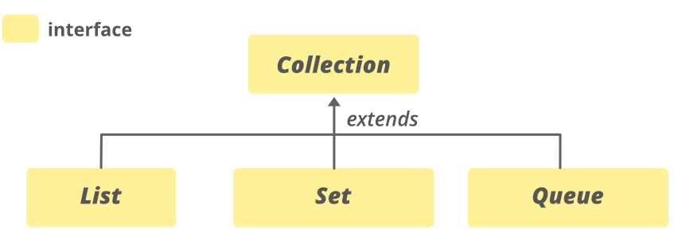
Collection interface
The Collection interface is the interface which is implemented by all the classes in the collection framework.
Some of the methods of Collection interface are Boolean add ( Object obj), Boolean addAll ( Collection c), void clear(), etc. which are implemented by all the subclasses of Collection interface.
Some types of collections allow duplicate elements, and others do not. Some are ordered and others are unordered

Slide 65
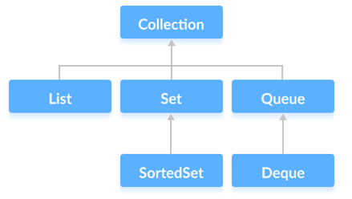
The Collection interface is the root interface of the Java collections framework.
There is no direct implementation of this interface. However, it is implemented through its subinterfaces like List, Set, and Queue.
For example, the ArrayList class implements the List interface which is a subinterface of the Collection Interface.

Slide 66
The Collection interface includes subinterfaces that are implemented by various classes in Java.
The List interface is an ordered collection that allows us to add and remove elements like an array.
The Set interface allows us to store elements in different sets similar to the set in mathematics. It cannot have duplicate elements.
The Queue interface is used when we want to store and access elements in First In, First Out(FIFO) manner.

Slide 67
Methods of Collection
The Collection interface includes various methods that can be used to perform different operations on objects. These methods are available in all its subinterfaces.
add() - inserts the specified element to the collection
size() - returns the size of the collection
remove() - removes the specified element from the collection
iterator() - returns an iterator to access elements of the collection
addAll() - adds all the elements of a specified collection to the collection
removeAll() - removes all the elements of the specified collection from the collection
clear() - removes all the elements of the collection

Slide 68
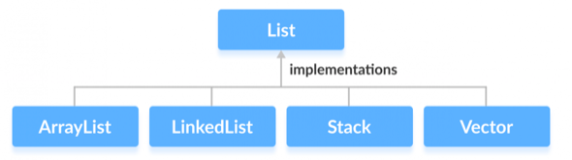
List Interface
In Java, the List interface is an ordered collection that allows us to store and access elements sequentially. It extends the Collection interface.
Since List is an interface, we cannot create objects from it.
In order to use functionalities of the List interface, we can use these classes:
ArrayList
LinkedList
Vector
Stack
These classes are defined in the Collections framework and implement the Listinterface.

Slide 69
How to use List?
In Java, we must import java.util.List package in order to use List.
// ArrayList implementation of List
List<String> list1 = new ArrayList<>();
// LinkedList implementation of List
List<String> list2 = new LinkedList<>();
Here, we have created objects list1 and list2 of classes ArrayList and LinkedList. These objects can use the functionalities of the List interface.

Slide 70
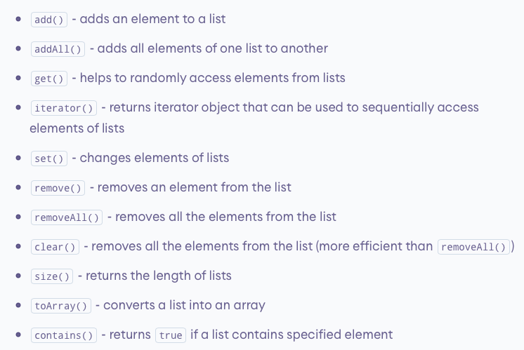
Methods in List
The List interface includes all the methods of the Collection interface. Its because Collection is a super interface of List.
Some of the commonly used methods of the Collection interface that's also available in the List interface are:

Slide 71
Implementation of the List Interface
import java.util.List;
import java.util.ArrayList;
class Main {
public static void main(String[] args) {
// Creating list using the ArrayList class
List<Integer> numbers = new ArrayList<>();
// Add elements to the list
numbers.add(1);
numbers.add(2);
numbers.add(3);
System.out.println("List: " + numbers);
// Access element from the list
int number = numbers.get(2);
System.out.println("Accessed Element: " + number);
// Remove element from the list
int removedNumber = numbers.remove(1);
System.out.println("Removed Element: " + removedNumber);
}
}
1. Implementing the ArrayList Class
Output:
List: [1, 2, 3]
Accessed Element: 3
Removed Element: 2

Slide 72
import java.util.List;
import java.util.LinkedList;
class Main {
public static void main(String[] args) {
// Creating list using the LinkedList class
List<Integer> numbers = new LinkedList<>();
// Add elements to the list
numbers.add(1);
numbers.add(2);
numbers.add(3);
System.out.println("List: " + numbers);
// Access element from the list
int number = numbers.get(2);
System.out.println("Accessed Element: " + number);
// Using the indexOf() method
int index = numbers.indexOf(2);
System.out.println("Position of 3 is " + index);
// Remove element from the list
int removedNumber = numbers.remove(1);
System.out.println("Removed Element: " + removedNumber);
}
}
2. Implementing the LinkedList Class
Output:
List: [1, 2, 3]
Accessed Element: 3
Position of 3 is 1
Removed Element: 2
LinkedList indexOf() method in Java
LinkedList. indexOf(Object element) method is used to check and find the occurrence of a particular element in the list. If the element is present then the index of the first occurrence of the element is returned otherwise -1 is returned if the list does not contain the element.

Slide 73
Java List vs. Set
Both the List interface and the Set interface inherits the Collection interface. However, there exists some difference between them.
Lists can include duplicate elements. However, sets cannot have duplicate elements.
Elements in lists are stored in some order. However, elements in sets are stored in groups like sets in mathematics.

Slide 74
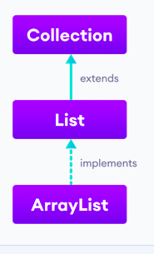
Java ArrayList
In Java, we use the ArrayList class to implement the functionality of resizable-arrays.
It implements the List interface of the collections framework.
Java ArrayList Vs Array
In Java, we need to declare the size of an array before we can use it. Once the size of an array is declared, it's hard to change it.
To handle this issue, we can use the ArrayList class. It allows us to create resizable arrays.
Unlike arrays, arraylists can automatically adjust their capacity when we add or remove elements from them. Hence, arraylists are also known as dynamic arrays.

Slide 75
Creating an ArrayList
Before using ArrayList, we need to import the java.util.ArrayList package first. Here is how we can create arraylists in Java:
Syntax - ArrayList<Type> arrayList= new ArrayList<>();
Here, Type indicates the type of an arraylist. For example,
// create Integer type arraylist
ArrayList<Integer> arrayList = new ArrayList<>();
// create String type arraylist
ArrayList<String> arrayList = new ArrayList<>();
In the above program, we have used Integer not int. It is because we cannot use primitive types while creating an arraylist. Instead, we have to use the corresponding wrapper classes. Here, Integer is the corresponding wrapper class of int.

Slide 76
Create an arraylist
import java.util.ArrayList;
class Main {
public static void main(String[] args){
// create ArrayList
ArrayList<String> languages = new ArrayList<>();
// Add elements to ArrayList
languages.add("Java");
languages.add("Python");
languages.add("Swift");
System.out.println("ArrayList: " + languages);
}
}
In the above example, we have created an ArrayList named languages.
Here, we have used the add() method to add elements to the arraylist.
Output: ArrayList: [Java, Python, Swift]

Slide 77
Basic Operations on ArrayList
The ArrayList class provides various methods to perform different operations on arraylists. We will look at some commonly used arraylist operations in this tutorial:
Add elements
Access elements
Change elements
Remove elements

Slide 78
Add element
import java.util.ArrayList;
class Main {
public static void main(String[] args){
// create ArrayList
ArrayList<String> languages = new ArrayList<>();
// add() method without the index parameter
languages.add("Java");
languages.add("C");
languages.add("Python");
System.out.println("ArrayList: " + languages);
}
}
Output: ArrayList: [Java, Python, Swift]

Slide 79
Access Elements
import java.util.ArrayList;
class Main {
public static void main(String[] args) {
ArrayList<String> animals = new ArrayList<>();
// add elements in the arraylist
animals.add("Cat");
animals.add("Dog");
animals.add("Cow");
System.out.println("ArrayList: " + animals);
// get the element from the arraylist
String str = animals.get(1);
System.out.print("Element at index 1: " + str);
}
}
To access an element from the arraylist,
we use the get() method of the ArrayListclass.
we have used the get() method with parameter 1. Here, the method returns the element at index 1.
H/W:
We can also access elements of the ArrayList using the iterator() method.
Output:
ArrayList: [Cat, Dog, Cow]
Element at index 1: Dog

Slide 80
Change Elements
import java.util.ArrayList;
class Main {
public static void main(String[] args) {
ArrayList<String> languages = new ArrayList<>();
// add elements in the array list
languages.add("Java");
languages.add("Kotlin");
languages.add("C++");
System.out.println("ArrayList: " + languages);
// change the element of the array list
languages.set(2, "JavaScript");
//Here, the set() method changes the element at index //2 to JavaScript.
System.out.println("Modified ArrayList: " + languages);
}
}
To change elements of the arraylist, we use the set() method of the ArrayList class.
Output:
ArrayList: [Java, Kotlin, C++]
Modified ArrayList: [Java, Kotlin, JavaScript]
In the above example, we have created an ArrayList named languages

Slide 81
Remove ArrayList Elements
import java.util.ArrayList;
class Main {
public static void main(String[] args) {
ArrayList<String> animals = new ArrayList<>();
// add elements in the array list
animals.add("Dog");
animals.add("Cat");
animals.add("Horse");
System.out.println("ArrayList: " + animals);
// remove element from index 2
String str = animals.remove(2);
System.out.println("Updated ArrayList: " + animals);
System.out.println("Removed Element: " + str);
}
}
To remove an element from the arraylist, we can use the remove() method of the ArrayList class.
Output:
ArrayList: [Dog, Cat, Horse]
Updated ArrayList: [Dog, Cat]
Removed Element: Horse
Here, the remove() method takes the index number as the parameter. And, removes the element specified by the index number.

Slide 82
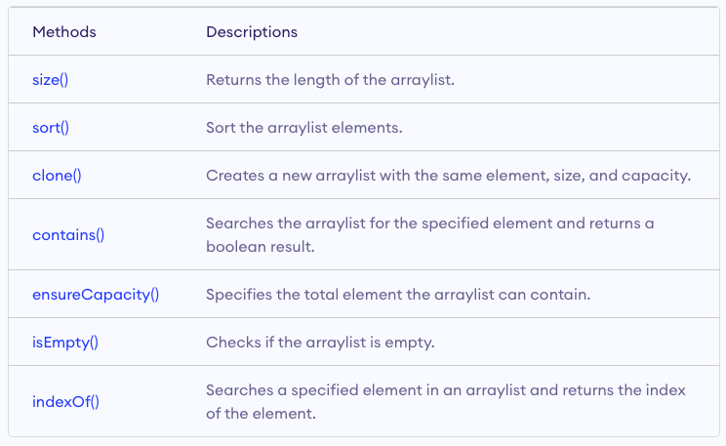
Methods of ArrayList Class
we have learned about the add(), get(), set(), and remove() method of the ArrayList class.
Besides those basic methods, here are some more ArrayList methods that are commonly used.

Slide 83
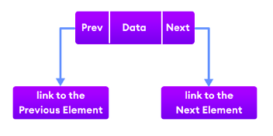
Java LinkedList
The LinkedList class of the Java collections framework provides the functionality of the linked list data structure (doubly linkedlist).
Each element in a linked list is known as a node.
It consists of 3 fields:
Prev - stores an address of the previous element in the list. It is null for the first element
Next - stores an address of the next element in the list. It is null for the last element
Data - stores the actual data

Slide 84
Create a Linkedlist
Here is how we can create linked lists in Java:
LinkedList<Type> linkedList = new LinkedList<>();
Here, Type indicates the type of a linked list. For example,
// create Integer type linked list
LinkedList<Integer> linkedList = new LinkedList<>();
// create String type linked list
LinkedList<String> linkedList = new LinkedList<>();

Slide 85
Creating a LinkedList
import java.util.LinkedList;
class Main {
public static void main(String[] args){
// create linkedlist
LinkedList<String> animals = new LinkedList<>();
// Add elements to LinkedList
animals.add("Dog");
animals.add("Cat");
animals.add("Cow");
animals.add(”Buffalo");
System.out.println("LinkedList: " + animals);
}
}
Output:
LinkedList: [Dog, Cat, Cow, Buffalo]
Here, we have used the add() method to add elements to the LinkedList.

Slide 86
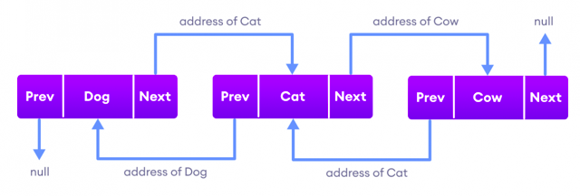
Working
Elements in linked lists are not stored in sequence. Instead, they are scattered and connected through links (Prev and Next).

Slide 87
Here we have 3 elements in a linked list.
Dog - it is the first element that holds null as previous address and the address of Cat as the next address
Cat - it is the second element that holds an address of Dog as the previous address and the address of Cow as the next address
Cow - it is the last element that holds the address of Cat as the previous address and null as the next element

Slide 88
Methods of Java LinkedList
LinkedList provides various methods that allow us to perform different operations in linked lists.
Add elements
Access elements
Change elements
Remove elements

Slide 89
Add Elements
import java.util.LinkedList;
class Main {
public static void main(String[] args){
// create linkedlist
LinkedList<String> animals = new LinkedList<>();
// add() method without the index parameter
animals.add("Dog");
animals.add("Cat");
animals.add("Cow");
System.out.println("LinkedList: " + animals);
// add() method with the index parameter
animals.add(1, "Horse");
//Here, we have used //the index number parameter. It is an optional //parameter that specifies the position where the new //element is added.
System.out.println("Updated LinkedList: " + animals);
}
}
Add Rabbit at index 3
Output:
LinkedList: [Dog, Cat, Cow]
Updated LinkedList: [Dog, Horse, Cat, Cow]

Slide 90
Access LinkedList elements
import java.util.LinkedList;
class Main {
public static void main(String[] args) {
LinkedList<String> languages = new LinkedList<>();
// add elements in the linked list
languages.add("Python");
languages.add("Java");
languages.add("JavaScript");
System.out.println("LinkedList: " + languages);
// get the element from the linked list
String str = languages.get(1);
System.out.print("Element at index 1: " + str);
}
}
we have used the get() method with parameter 1. Here, the method returns the element at index 1.
H/W: We can also access elements of the LinkedList using the iterator() and the listIterator() method.
Output:
LinkedList: [Python, Java, JavaScript]
Element at index 1: Java

Slide 91
Change Elements of a LinkedList
import java.util.LinkedList;
class Main {
public static void main(String[] args) {
LinkedList<String> languages = new LinkedList<>();
// add elements in the linked list
languages.add("Java");
languages.add("Python");
languages.add("JavaScript");
languages.add("Java");
System.out.println("LinkedList: " + languages);
// change elements at index 3
languages.set(3, "Kotlin"); //Here, the set() method //changes the element at index 3 to Kotlin.
System.out.println("Updated LinkedList: " + languages);
}
}
Output:
LinkedList: [Java, Python, JavaScript, Java]
Updated LinkedList: [Java, Python, JavaScript, Kotlin]

Slide 92
Remove element from a LinkedList
import java.util.LinkedList;
class Main {
public static void main(String[] args) {
LinkedList<String> languages = new LinkedList<>();
// add elements in LinkedList
languages.add("Java");
languages.add("Python");
languages.add("JavaScript");
languages.add("Kotlin");
System.out.println("LinkedList: " + languages);
// remove elements from index 1
String str = languages.remove(1);
System.out.println("Removed Element: " + str);
System.out.println("Updated LinkedList: " + languages);
}
}
Here, the remove() method takes the index number as the parameter. And, removes the element specified by the index number.
Output:
LinkedList: [Java, Python, JavaScript, Kotlin]
Removed Element: Python
New LinkedList: [Java, JavaScript, Kotlin]

Slide 93
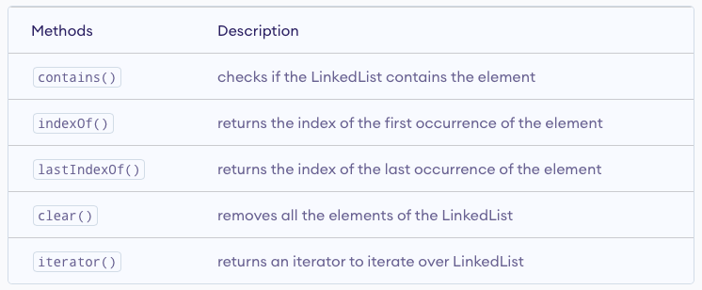
Other Methods

Slide 94
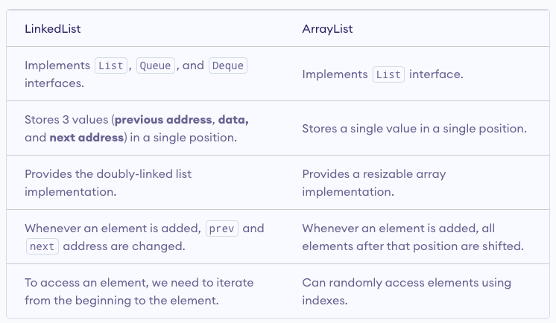
LinkedList Vs. ArrayList

Slide 95
Java Vector
The Vector class is an implementation of the List interface that allows us to create resizable-arrays similar to the ArrayList class. Java Vectors vs ArrayList
In Java, both ArrayList and Vector implements the List interface and provides the same functionalities. However, there exist some differences between them. The Vector class synchronizes each individual operation.
This means whenever we want to perform some operation on vectors, the Vector class automatically applies a lock to that operation. It is because when one thread is accessing a vector, and at the same time another thread tries to access it, an exception called ConcurrentModificationException is generated. ‘
Hence, this continuous use of lock for each operation makes vectors less efficient.However, in array lists, methods are not synchronized. Instead, it uses the Collections.synchronizedList() method that synchronizes the list as a whole.

Slide 96
Creating a Vector
Vector<Type> vector = new Vector <>();
Here, Type indicates the type of a linked list.
// create Integer type linked list
Vector<Integer> vector= new Vector <>();
// create String type linked list
Vector<String> vector= new Vector <>();

Slide 97
Add elements
add(element) - adds an element to vectors
add(index, element) - adds an element to the specified position
addAll(vector) - adds all elements of a vector to another vector
import java . util . Vector ; class vector1 { public static void main(String [] args) {
Vector<String> mammals= new Vector <>();
mammals.add(”Dog”); mammals .add (” Horse ” ) ; mammals.add(2, ”Cat”);
System.out.println(”Vector: ” + mammals);
Vector<String> animals = new Vector <>();
animals . add(” Crocodile ”); a n i m a l s . a d d A l l ( mammals ) ; System . out . println (”New Vector : ” + animals );
}}
Output:
Vector: Dog, Horse, Cat
New Vector: Crocodile, Dog, Horse, Cat

Slide 98
Access Vector elements
get(index) - returns an element specified by the index
iterator() - returns an iterator object to sequentially access vector elements
import java . util . Iterator ; import java . util . Vector ; class vector2 { public static void main(String [] args) {
Vector<String> animals= new Vector <>();
animals .add(”Dog”);
animals .add(”Horse ”);
animals .add(”Cat”);
String element = animals . get (2);
System.out.println(”Element at index 2: ” + element); Iterator<String> iterate = animals.iterator(); System . out . print (” Vector : ”); while(iterate.hasNext()) { System . out . print ( iterate . next ()); System.out.print(”, ”); }}}
Output:
Cat
Dog
Horse
Cat

Slide 99
Remove Vector elements
remove(index) - removes an element from specified position
removeAll() - removes all the elements
clear() - removes all elements. It is more efficient than removeAll()
import java . util . Vector ; class vector3{ public static void main(String [] args) {
Vector<String> animals= new Vector <>();
animals .add(”Dog”); animals .add(”Horse ”); animals .add(”Cat”);
System.out.println(”Initial Vector: ” + animals);
String element = animals . remove (1); System.out.println(”Removed Element: ” + element);
System . out . println (”New Vector : ” + animals );
animals . clear ();
System.out.println(”Vector after clear(): ” + animals)
}}
Output:
Initial Vector: Dog, Horse, Cat
Removed Element: Dog, Cat
Vector after clear(): null

Slide 100
Other Vector methods
set()-changes an element of the vector
size()–returns the size of the vector
toArray()-converts the vector into an array
toString()-converts the vector into a String
contains()-searches the vector for specified element and returns a boolean result

Slide 101
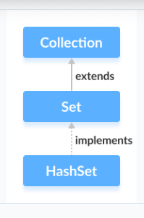
Java Hashset
The HashSet class of the Java Collections framework provides the functionalities of the hash table data structure.

Slide 102
Why Hashset?
In Java, HashSet is commonly used if we have to access elements randomly. It is because elements in a hash table are accessed using hash codes.
The hashcode of an element is a unique identity that helps to identify the element in a hash table.
HashSet cannot contain duplicate elements. Hence, each hash set element has a unique hashcode.
Note: HashSet is not synchronized. That is if multiple threads access the hash set at the same time and one of the threads modifies the hash set. Then it must be externally synchronized.

Slide 103
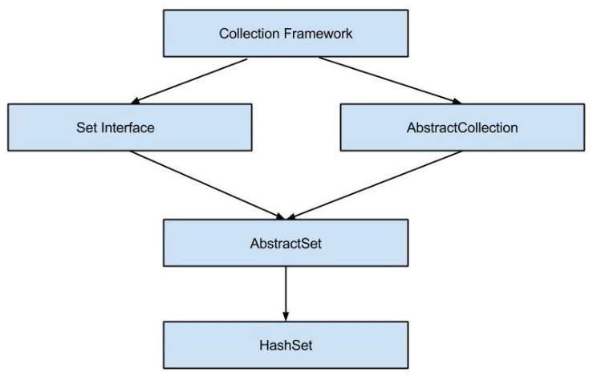

Slide 104
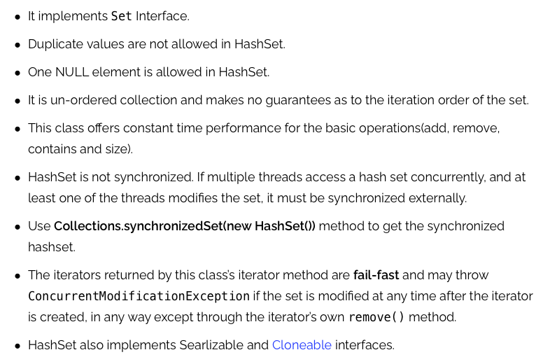
Hashset Features

Slide 105
Creating a HashSet
In order to create a hash set, we must import the java.util.HashSet package first.
Once we import the package, here is how we can create hash sets in Java.
// HashSet with 8 capacity and 0.75 load factor
HashSet<Integer> numbers = new HashSet<>(8, 0.75);
Here, we have created a hash set named numbers.
Notice, the part new HashSet<>(8, 0.75). Here, the first parameter is capacity, and the second parameter is loadFactor.
capacity - The capacity of this hash set is 8. Meaning, it can store 8 elements.
loadFactor - The load factor of this hash set is 0.6. This means, whenever our hash set is filled by 60%, the elements are moved to a new hash table of double the size of the original hash table.

Slide 106
Default capacity and load factor
It's possible to create a hash table without defining its capacity and load factor.
For example,
// HashSet with default capacity and load factor
HashSet<Integer> numbers1 = new HashSet<>();
By default,
the capacity of the hash set will be 16
the load factor will be 0.75
The load factor is a measure of how full the HashSet is allowed to get before its capacity is automatically increased. Default load factor is 0.75. This is called threshold

Slide 107
Methods of HashSet
The HashSet class provides various methods that allow us to perform various operations on the set.
Insert Elements to HashSet
add() - inserts the specified element to the set
addAll() - inserts all the elements of the specified collection to the set
import java.util.HashSet;
class Main {
public static void main(String[] args) {
HashSet<Integer> evenNumber = new HashSet<>();
// Using add() method
evenNumber.add(2);
evenNumber.add(4);
evenNumber.add(6);
System.out.println("HashSet: " + evenNumber);
HashSet<Integer> numbers = new HashSet<>();
// Using addAll() method
numbers.addAll(evenNumber);
numbers.add(5);
System.out.println("New HashSet: " + numbers);
}
}
Output:
HashSet: [2, 4, 6]
New HashSet: [2, 4, 5, 6]

Slide 108
Access HashSet Elements
To access the elements of a hash set, we can use the iterator() method.
In order to use this method, we must import the java.util.Iterator package.
import java.util.HashSet;
import java.util.Iterator;
class Main {
public static void main(String[] args) {
HashSet<Integer> numbers = new HashSet<>();
numbers.add(2);
numbers.add(5);
numbers.add(6);
System.out.println("HashSet: " + numbers);
// Calling iterator() method
Iterator<Integer> iterate = numbers.iterator();
System.out.print("HashSet using Iterator: ");
// Accessing elements
while(iterate.hasNext()) {
System.out.print(iterate.next());
System.out.print(", ");
}
}
}
Output:
HashSet: [2, 5, 6]
HashSet using Iterator: 2, 5, 6,

Slide 109
Remove Elements
remove() - removes the specified element from the set
removeAll() - removes all the elements from the set
import java.util.HashSet;
class Main {
public static void main(String[] args) {
HashSet<Integer> numbers = new HashSet<>();
numbers.add(2);
numbers.add(5);
numbers.add(6);
System.out.println("HashSet: " + numbers);
// Using remove() method
boolean value1 = numbers.remove(5);
System.out.println("Is 5 removed? " + value1);
boolean value2 = numbers.removeAll(numbers);
System.out.println("Are all elements removed? " + value2);
}
}
HashSet: [2, 5, 6]
Is 5 removed? true
Are all elements removed? true

Slide 110
Set Operations
The various methods of the HashSet class can also be used to perform various set operations.
Union of Sets
To perform the union between two sets, we can use the addAll() method.
import java.util.HashSet;
class Main {
public static void main(String[] args) {
HashSet<Integer> evenNumbers = new HashSet<>();
evenNumbers.add(2);
evenNumbers.add(4);
System.out.println("HashSet1: " + evenNumbers);
HashSet<Integer> numbers = new HashSet<>();
numbers.add(1);
numbers.add(3);
System.out.println("HashSet2: " + numbers);
// Union of two set
numbers.addAll(evenNumbers);
System.out.println("Union is: " + numbers);
}
}
Output:
HashSet1: [2, 4]
HashSet2: [1, 3]
Union is: [1, 2, 3, 4]

Slide 111
Intersection of Sets
To perform the intersection between two sets, we can use the retainAll()method.
import java.util.HashSet;
class Main {
public static void main(String[] args) {
HashSet<Integer> primeNumbers = new HashSet<>();
primeNumbers.add(2);
primeNumbers.add(3);
System.out.println("HashSet1: " + primeNumbers);
HashSet<Integer> evenNumbers = new HashSet<>();
evenNumbers.add(2);
evenNumbers.add(4);
System.out.println("HashSet2: " + evenNumbers);
// Intersection of two sets
evenNumbers.retainAll(primeNumbers);
System.out.println("Intersection is: " + evenNumbers);
}
}
Output:
HashSet1: [2, 3]
HashSet2: [2, 4]
Intersection is: [2]

Slide 112
Difference of Sets
To calculate the difference between the two sets, we can use the removeAll()method.
import java.util.HashSet;
class Main {
public static void main(String[] args) {
HashSet<Integer> primeNumbers = new HashSet<>();
primeNumbers.add(2);
primeNumbers.add(3);
primeNumbers.add(5);
System.out.println("HashSet1: " + primeNumbers);
HashSet<Integer> oddNumbers = new HashSet<>();
oddNumbers.add(1);
oddNumbers.add(3);
oddNumbers.add(5);
System.out.println("HashSet2: " + oddNumbers);
// Difference between HashSet1 and HashSet2
primeNumbers.removeAll(oddNumbers);
System.out.println("Difference : " + primeNumbers);
}
}
Output:
HashSet1: [2, 3, 5]
HashSet2: [1, 3, 5]
Difference: [2]

Slide 113
Subset
To check if a set is a subset of another set or not, we can use the containsAll()method.
import java.util.HashSet;
class Main {
public static void main(String[] args) {
HashSet<Integer> numbers = new HashSet<>();
numbers.add(1);
numbers.add(2);
numbers.add(3);
numbers.add(4);
System.out.println("HashSet1: " + numbers);
HashSet<Integer> primeNumbers = new HashSet<>();
primeNumbers.add(2);
primeNumbers.add(3);
System.out.println("HashSet2: " + primeNumbers);
// Check if primeNumbers is a subset of numbers
boolean result = numbers.containsAll(primeNumbers);
System.out.println("Is HashSet2 is subset of HashSet1? " + result);
}
}
Output:
HashSet1: [1, 2, 3, 4]
HashSet2: [2, 3]
Is HashSet2 is a subset of HashSet1? true

Slide 114
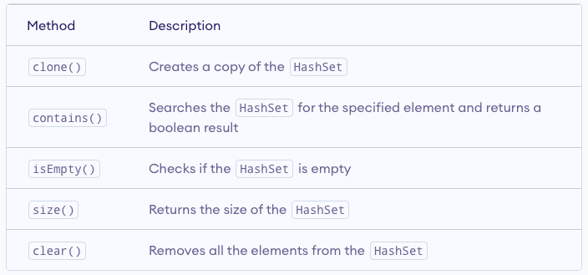
Other Methods of Hashset

Slide 115
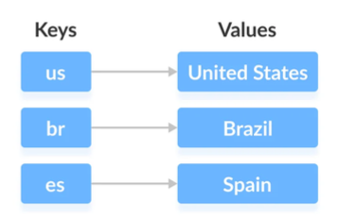
Java Map Interface
The Map interface of the Java collections framework provides the functionality of the map data structure.
Working of Map In Java, elements of Map are stored in key/value pairs. Keys are unique values associated with individual Values.
A map cannot contain duplicate keys. And, each key is associated with a single value.

Slide 116
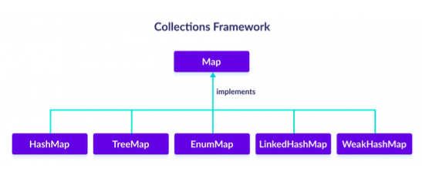
We can access and modify values using the keys associated with them.
The Map interface maintains 3 different sets:
a) the set of keys
b) the set of values
c) the set of key/value associations (mapping).
Hence we can access keys, values, and associations individually.

Slide 117
Create HashMap
In order to create a hash map, we must import the java.util.HashMap pack- age first. Once we import the package, here is how we can create hashmaps in Java.
HashMap<K, V> numbers = new HashMap<>();
In the above code, we have created a hashmap named numbers. Here, K
represents the key type and V represents the type of values.
HashMap<String , Integer > numbers = new HashMap<>();

Slide 118
Methods of MaP
put(K, V) - Inserts the association of a key K and a value V into the map. If the key is already present, the new value replaces the old value.
putAll() - Inserts all the entries from the specified map to this map.
putIfAbsent(K, V) - Inserts the association if the key K is not already associated with the value V.
get(K) - Returns the value associated with the specified key K. If the key is not found, it returns null.
getOrDefault(K, defaultValue) - Returns the value associated with the specified key K. If the key is not found, it returns the defaultValue.
containsKey(K) - Checks if the specified key K is present in the map or not.
containsValue(V) - Checks if the specified value V is present in the map or not.
replace(K, V) - Replace the value of the key K with the new specified value V.
replace(K, oldValue, newValue) - Replaces the value of the key K with the new value newValue only if the key K is associated with the value oldValue.
remove(K) - Removes the entry from the map represented by the key K.
remove(K, V) - Removes the entry from the map that has key K associated with value V.
keySet() - Returns a set of all the keys present in a map. values() - Returns a set of all the values present in a map.
entrySet() - Returns a set of all the key/value mapping present in a map.

Slide 119
Implementing HashMap Class
import java . util .Map; import java . util .HashMap; class map1 { public static void main(String [] args) {
Map<String , Integer > numbers = new HashMap<>();
numbers.put(”One”, 1); numbers.put(”Two”, 2); System . out . println (”Map: ” + numbers );
System.out.println(”Keys: ” + numbers.keySet());
System.out.println(”Values: ” + numbers.values());
System.out.println(”Entries: ” + numbers.entrySet());
int value = numbers.remove(”Two”);
System . out . println (”Removed Value : ” + value );
}}
Output:
Map: {One = 1, Two = 2}
Keys: [One, Two]
Values: [1,2]
Entries: [One = 1, Two = 2]
Removed Value: 2

Slide 120
Add Elements
Output:
Initial HashMap: { }
HashMap after put(): {One = 1, Two = 2, Three = 3}
import java . util .HashMap; class map4 { public static void main(String [] args) {
HashMap<String , Integer > numbers = new HashMap<>();
System.out.println(”Initial HashMap: ” + numbers);
numbers.put(”One”, 1); numbers.put(”Two”, 2);
numbers.put(”Three”, 3); System.out.println(”HashMap after put(): ” + numbers);
}}

Slide 121
Access HashMap Elements
import java . util .HashMap; class map5 { public static void main(String [] args) {
HashMap<Integer , String> languages = new HashMap<>();
languages.put(1, ”Java”); languages . put (2 , ”Python ”); languages.put(3, ”JavaScript”);
System.out.println(”HashMap: ” + languages);
String value = languages . get (1);
System.out.println(”Value at key 1: ” + value);
}}
Output:
HashMap: {1=Java, 2=Python, 3=JavaScript}
Value at key 1: Java

Slide 122
Change HashMap value
import java . util .HashMap; class map6 { public static void main(String [] args) {
HashMap<Integer , String> languages = new HashMap<>();
languages.put(1, ”Java”); languages . put (2 , ”Python ”); languages.put(3, ”JavaScript”);
System.out.println(”Original HashMap: ” + languages);
languages . replace (2 , ”C++”);
System.out.println(”HashMap using replace(): ” + languages);
}}
Output:
Original HashMap: {1=Java, 2=Python, 3=JavaScript }
HashMap using replace(): {1=Java, 2=C++, 3=JavaScript}

Slide 123
Remove HashMap elements
import java . util .HashMap; class map7 { public static void main(String [] args) {
HashMap<Integer , String> languages = new HashMap<>();
languages.put(1, ”Java”); languages . put (2 , ”Python ”); languages.put(3, ”JavaScript”);
System.out.println(”HashMap: ” + languages);
String value = languages . remove (2); System . out . println (”Removed value : ” + value );
System.out.println(”Updated HashMap: ” + languages);
}}
Output:
HashMap: {1=Java, 2=Python, 3=JavaScript}
Removed value: [Python]
Updated HashMap: {1=Java, 3=JavaScript}

Slide 124
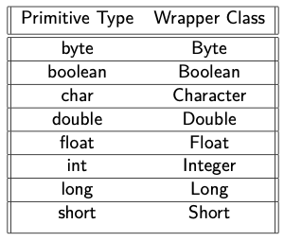
Java Wrapper classes
The wrapper classes in Java are used to convert primitive types (int, char, float, etc) into corresponding objects.
Each of the 8 primitive types has corresponding wrapper classes.

Slide 125
Convert Primitive Type to Wrapper Objects
We can also use the valueOf() method to convert primitive types into corresponding objects.
class wrapper1 { public static void main(String [] args) {
int a=5; double b = 5.65; Integer aObj = Integer.valueOf(a);
Double bObj = Double.valueOf(b);
if(aObj instanceof Integer) { System.out.println(”An object of Integer is created.”) }
if (bObj instanceof Double) { System.out.println(”An object of Double is created.”);
}}}
Output:
An object of Integer is created.
An object of Double is created.

Slide 126
In the above example, we have used the valueOf() method to convert the primitive types into objects.
Here, we have used the instanceof operator to check whether the generated objects are of Integer or Double type or not.
However, the Java compiler can directly convert the primitive types into corresponding objects. This process is known as auto-boxing.

Slide 127
Wrapper Objects into Primitive Types
class wrapper2 { public static void main(String [] args) {
} }
// creates objects of wrapper class
Integer aObj = Integer . valueOf (23);
Double bObj = Double . valueOf (5.55);
// converts into primitive types int a = aObj.intValue(); double b = bObj.doubleValue();
System.out.println(”The value of a: ” + a);
System.out.println(”The value of b:” + b); }}
In the above example, we have used the intValue() and doubleValue() method to convert the Integer and Double objects into corresponding primitive types.
Output:
The value of a: 23
The value of b: 5.55

Slide 128
Java autoboxing
import java . util . ArrayList ; class auto { public static void main(String [] args) {
ArrayList<Integer> list = new ArrayList <>(); //autoboxing
list .add(5);
list .add(6);
System.out.println(”ArrayList: ” + list);
} }
Output:
ArrayList: 5,6

Slide 129
Java Unboxing
import java . util . ArrayList ; class unbox { public static void main(String [] args) {
ArrayList<Integer> list = new ArrayList <>();
//autoboxing
list .add(5);
list .add(6);
System.out.println(”ArrayList: ” + list); // unboxing
int a= list.get(0);
System.out.println(”Value at index 0: ” + a);
}}
Output:
ArrayList: 5,6
Value at index 0: 5

Slide 130
Java Generics
Java Generics is a set of related methods or a set of similar types.
Generics allow types Integer, String, or even user-defined types to be passed as a parameter to classes, methods, or interfaces.
Generics are mostly used by classes like HashSet or HashMap.

Slide 131
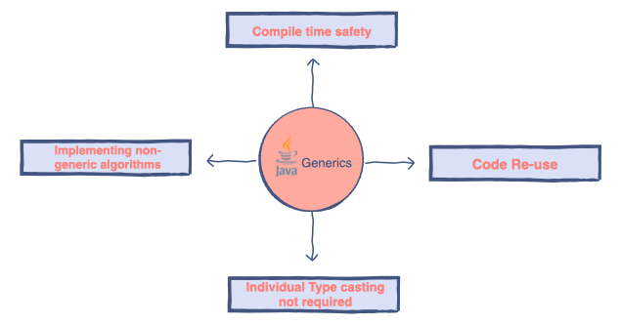
Advantages
Generics ensure compile-time safety which allows the programmer to catch the invalid types while compiling the code.
Java Generics helps the programmer to reuse the code for whatever type he/she wishes. For instance, a programmer writes a generic method for sorting an array of objects. Generics allow the programmer to use the same method for Integer arrays, Double arrays, and even String arrays.
Another advantage of using generics is that Individual typecasting isn’t required. The programmer defines the initial type and then lets the code do its job.
It allows us to implement non-generic algorithms.

Slide 132
The Java Generics allows us to create a single class, interface, and method that can be used with different types of data (objects).
This helps us to reuse our code.
Java Generics Class: We can create a class that can be used with any type of data. Such a class is known as Generics Class.

Slide 133
class Main {
public static void main(String[] args) {
// initialize the class with Integer data
DemoClass demo = new DemoClass();
// generics method working with String
demo.<String>genericsMethod("Java Programming");
// generics method working with integer
demo.<Integer>genericsMethod(25);
}
}
class DemoClass {
// create a generics method
public <T> void genericsMethod(T data) {
System.out.println("Generics Method:");
System.out.println("Data Passed: " + data);
}
}
Output:
Generics Method:
Data Passed: Java Programming
Generics Method:
Data Passed: 25
public <T> void genericMethod(T data)
{...}
Here, the type parameter < T > is inserted after the modifier public and before the return type void. We can call the generics method by placing the actual type < String > and < Integer > inside the bracket before the method name.
demo.<String>genericMethod(”Java Programming”); demo.<Integer>genericMethod (25);

Slide 134
Java Generic Method
public class TestGenerics4{
public static < E > void printArray(E[] elements) {
for ( E element : elements){
System.out.println(element );
}
System.out.println();
}
public static void main( String args[] ) {
Integer[] intArray = { 10, 20, 30, 40, 50 };
Character[] charArray = { ’V', ’I', ’T', 'A', ’P',};
System.out.println( "Printing Integer Array" );
printArray( intArray );
System.out.println( "Printing Character Array" );
printArray( charArray );
}
}
Similar to the generics class, we can also create a method that can be used with any type of data. Such a class is known as Generics Method.
In the above example, we have created a generic method named generics Method.
Output:
Print Integer Array
10 20 30 40 50
Print Character Array
VITAP

Slide 135
Bounded Types
class GenericsClass <T extends Number> { public void display () { System.out.println(” bounded type generics class.”);
}} class gen3 { public static void main(String [] args) {
// create an object of GenericsClass
GenericsClass<String> obj = new GenericsClass <>();
} }
In general, the type parameter can accept any data types (except primitive types). However, if we want to use generics for some specific types (such as accept data of number types) only, then we can use bounded types.
In the case of bound types, we use the extends keyword. For example, <T extends A>
This means T can only accept data that are subtypes of A.
Output:
Type argument java.lang
String is not within bounds of type variable T

